Slide 1

The Impact of the 2011 Assault Guideline
Jose Pina-Sánchez & Robin Linacre
Notes:
I am going to talk about a paper that I wrote when I was working at the Sentencing Council, which is a government body linked to the Ministry of Justice, I wrote it in collaboration with Robin Linacre who is the Economic Advisor of the Council.
In this study what we try to do is to assess the impact of a new sentencing guideline for assault offences that came into force two years ago.
In particular we want to assess whether the new guideline improved consistency in sentencing.
We are planning to send this paper to the journal of Quantitative Criminology in the next weeks, so if you have any comments or suggestion that could make it better please share that with me.
(Also, at the moment I am writing a paper reviewing the different methods that can be used to assess consistency, so if you have ever thought about this research question before or if you are currently using a method that you think could be potentially used here please let me know.)

Slide 2
Index
The Sentencing Guidelines
On the Measurement of Consistency
Longitudinal Study of Residuals
Exact Matching
Conclusion
Notes:
a) Ok, so this is how I am going to structure this talk.
1) I start introducing the system of guidelines which originated in the US and has been recently implemented in England and Wales, the assault guidelines, the one we analyse, being one of them.
I am going to spend a bit longer than what is customary for an introduction since I believe that most of you are economists and might not be familiar with the topic of the sentencing guidelines.
2) I continue with an explanation on how consistency in sentencing has been measured so far in England and Wales, and about how a new dataset that came about in 2011 might revolutionise the field of sentencing in this country.
3&4) After that I present the two methods that we used, we call the first dispersion of residuals and the second exact matching.
5) I will conclude with a brief summary of our findings.

Slide 3
The Origin: the US federal guidelines
The first sentencing guidelines were implemented in the 1980s in the federal courts of the US,
partly in response to the influential work by Marvin Frankel (1972) “lawlessness in sentencing”, where the author depicted a system prone to discrimination, and unwarranted disparity in sentencing.
To tackle this problem a set of sentencing guidelines were designed.
The goal of the guidelines is to make sentencing a more structured process in order to achieve greater transparency, consistency and predictability.
Notes:
4) Before the guidelines, sentencers had to rely on caselaw (precedents), on their experience, and discretion;
The sentencing guidelines offer specific guidance in the form of a flowchart that judges can consult to decide the sentence outcome.

Slide 4


The Sentencing Guidelines
Notes:
Allow me to illustrate this graphically,

Slide 5
The Guidelines in England and Wales
Sentencers’ discretion in England and Wales was only restrained by statutory minima and/or maxima set for some offences, and by the Court of Appeal
The Criminal Justice Act (2003) created the Sentencing Guidelines Council, which designed the first sentencing guidelines for England and Wales, one of those was the first assault guideline implemented in 2007.
The Coroners and Justice Act (2009) changed the composition of the Council, and the enforceability of the guidelines.
The first guideline to be designed by the new Sentencing Council was the new assault guideline (2011) which replaced the previous one (2007).
Notes:
a) Recently (in the last decade) this system of guidelines got exported to the jurisdiction of England and Wales.
2) The England and Wales sentencing experience started with the Criminal Justice Act, passed in 2003,
3) Later, in 2009 a new law “The Coroners and Justice Act” was passed that would reinforce the system of guidelines.
A key change was that whereas before Crown Court judges and magistrates were asked to have regard (to consider) to the guidelines when sentencing, the Coroners and Justice Act now specifies that sentencers must follow the guidelines.
This one sentences or one word captures a lot of meaning since it changes the nature of the guidelines.
4) And it is this transition form the old to the new guideline that we want to analyse, in particular its impact in terms of consistency in sentencing.

Slide 6
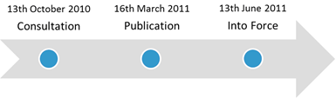
The 2011 Assault Guideline
In 2010 stakeholders were asked to express their opinion about the old guideline; issues of applicability and organisation were raised.
These problems were taken into account in the design of the new guideline: a) non-realistic scenarios were replaced, b) a structure of 9 steps was clearly defined.
Notes:
a) let me tell you a bit more about the new assault guideline before I start the more methodological part of the talk.
1) Stakeholders: judges, lawyers, members of the police,
Regarding lack of applicability it was flagged that most of the scenarios overemphasised premeditation, when most of the assaults are spontaneous;
Regarding organisation, it wasn’t clear the stages when legal factors of the offence or the offender such as use of weapons or showing remorse needed to be taken into account, or which weight they needed to be given.
2) non-realistic scenarios were replaced to improve applicability, and a new 9-step structure was defined where the legal factors to be used and their effect were identified at each step.
3) And here is the timeline for the development of the new assault guideline.
Following the consultation process, the new guideline was published in March 2011, and came into force the in June 2011.
It is important to notice the period of familiarisations that sentencers had since it was published until it came into force, some of them (mainly magistrates) even went through a training process.
Here we assess changes in consistency after the 13th of June of 2011.

Slide 7

On the Measurement of Consistency
Experimental data:
e.g. focus groups
Observational data:
e.g. the Court Proceedings Database
100
120
Notes:
We sis a literature review to find how consistency has been measured so far.
Consistency in sentencing seems a rather intuitive concept, the extent to which like cases are treated alike, however, measuring is not that straightforward.
1) For the jurisdiction of England and Wales only two type of studies have been used:
On the one hand we have quasi-experiments where different judges or Magistrates are asked to pass a sentence for a hypothetical case described; with this data we could just define consistency from a measure of dispersion such as the standard deviation.
There are two problems with this method: a) the most obvious is that the conditions of the sentencing process are not perfectly replicated by the experiment (judges lack full information, and they might put more or less attention than in a real case); b) issues of generalisation, we can only know about a the cases included in the experiment, and these might represent the universe of cases sentenced better or worse.
2) Other studies have relied on the Court Proceedings Database, published by the MoJ. From this data studies have attempted to measure dispersion in sentencing by looking at: a) dispersion in sentence outcomes by Courts, e.g. the percentage of custodial sentences by Court could tell us something about inter-Court variability, the problem is that there are so many confounding effects such as % of young people, % of unemployment, etc. determining crime that any variations in sentence outcome could not be taken as evidence of inconsistencies; b) a different method would be to look at dispersion in similar type of offences, the problem here is that there are a lot of characteristics of the offence that are not recorded in the CPD, so again there seems to be a problem of confounders.

Slide 8
The Crown Court Sentencing Survey
Census data on all sentences passed at Crown Courts.
Record offences in unprecedented detail: more than 60 aggravating and mitigating factors.
It is not perfect, there are issues of non-response (about 40%) and in some guidelines there have been change of formats in their questionnaires.
Notes:
In our study we use a new dataset, the CCSS, which is due to become publicly available next month.
2) This two features make it a unique dataset, there is nothing like this in the world,
so these are very exciting news for anyone doing research in this field.

Slide 9
Longitudinal Study of Residuals
We use data from the Crown Court Sentencing Survey in 2011, and we divide it in two blocks before and after June the 13th.
We run two regression models using the natural log of sentence length as the response variable and set of relevant legal factors.
Our rationale is to try to obtain a rough estimate that differentiates between variability that can be explained by legitimate sentencing practice, and other type of variability that might be capturing illegitimate sentencing.
Notes:
ok, so regarding the first method that we use to study consistency;
2) These are the number of previous convictions, whether the offender plead guilty, and others.
3) Ideally we would like to separate these legitimate mechanisms producing variability in sentencing from other illegitimate sources of variability, such as ethnicity, or whether the sentencer had a good lunch or just a cold sandwich for lunch.

Slide 10
Longitudinal Study of Residuals
 | Before | After
Constant | 5.78 (.03) | 5.52 (.05)
GBH | .39 (.02) | .55 (.03)
Intent | 1.51 (.03) | 1.74 (.03)
Prev. convictions | -.02 (.01) | .11 (.02)
First opportunity | -.09 (.02) | -.08 (.03)
Remorse | -.14 (.02) | -.13 (.03)
Carer | -.12 (.04) | -.16 (.11)
Gang | .03 (.02) | .02 (.04)
Vulnerable | .12 (.03) | .18 (.04)
Public worker | -.03 (.05) | -.10 (.06)
Sustained | .21 (.02) | .20 (.03)
Drugs | .06 (.02) | .01 (.03)
R2 | .55 | .62
Sample size | 2982 | 1949
Notes:
So, these are the variables that we used, the first two indicate the type of offence, and the rest are either aggravating or mitigating factors.
SEs are shown between brackets and the statistically significant coefficients appear in bold,
But the information that we wanted to highlight here is the change in R2s.

Slide 11
Dispersion of Residuals
The R² goes from .55 to .62, which means that the same set of legal factors now explain a higher part of the variability in sentence length.
Put it differently, the share of the variability due to unknown reasons has decreased.
However we should be careful in our interpretation, the unexplained variability is formed of illegitimate sources of variability, but it also captures other confounders such as: measurement error, misspecifications, and omitted relevant variables.
The R² will always be a biased estimate of consistency.
Notes:
3) By misspecification I mean issues such as failing to add an interaction, or keeping an effect as linear when it should be quadratic;
The R2 is only a biased measure of consistency.
Does not matter how many variables we use, measuring consistency from the R2 of a regression model will ultimately fail.

Slide 12
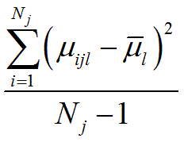
Longitudinal Study of Residuals
This impasse can be avoided if we shift the focus from trying to measure the actual level of consistency to detect changes in the patterns of consistency across 2011.
Assuming that the effect of omitted relevant variables, measurement error and misspecifications remain constant across 2011.
Instead of comparing R², we estimate patterns of inconsistency using the weekly variance of the residuals from the previous models.
Notes:
2) There was a change of format in the questionnaire after the new guideline came into force, which might have some implications in terms of ME, however, we specifically used variables which wording hasn’t changed at all, to minimise that impact and make our assumption more plausible.
In addition, we shouldn’t expect changes due to misspecifications, because the model is exactly the same for the before and after scenario.
Similarly, regarding the omission of variables, this shouldn’t be a major issue since we use the same set of explanatory variables.
So, they are not unrealistic hypotheses.
3) The R2 can only offer us a discrete vision of change: before and after, we would like to use something smoother, more continuous, something that allows us looking at the time when the guideline came into place.
In particular we use a variance-like formula to see the variability of residuals by week,
explain what each term is representing and indicate that the mean residual of the model is 0 by assumption of linear regression.

Slide 13
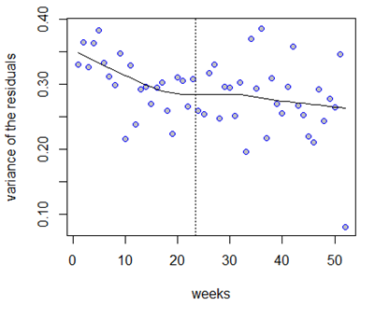
Longitudinal Study of Residuals
Notes:
So, we can obtain a scatterplot like this one, where the vertical line indicates when the new guideline came into force, and the line of best fit is a lowess curve, which is pointing at constant decreases in weekly residual variance across 2011 and especially during the first half of the year, which might be indicating the possibility of an anticipatory effect.
This actually makes sense if we take into consideration that judges took part in the designing process of the new guideline and that the guideline was published and sent to each judge 3 months before it came into place.
c) In particular the lowess curve at the last week is decreases 21% smaller than for the first week.
d) This seems alright, however it could be argued that what we see is the result of the variance in sentence length for offences of assault going down.
Remember sentence length was our response variable, so it could be that the effect of the legal factors is the same but the variability in sentence length has gone down and that’s what we see.

Slide 14
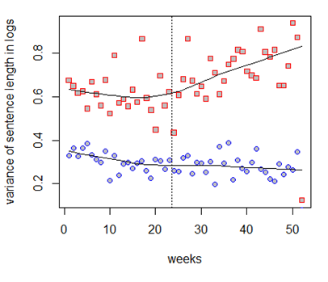
Longitudinal Study of Residuals
Notes:
So, to check that we do the same thing group, offences by weeks and calculate the weekly variance in sentence length.
The red squares, and we actually observe the opposite trend, variability in sentence length goes up after the new guideline came into place.
We are not too sure why that’s the case, the most plausible explanation is that this has something to do with the riots occurred in August 2011 (week 31), which probably meant a shock in the practice of sentencing.
In any case, regarding the issue of consistency, the new line is telling us that the improvement in consistency might be higher than what we previously inferred from the line of the residuals, that 21% reduction from the first to the last week. Since the unexplained variability of our model for legal factors goes down even in the presence of an increase in the variability of sentence length.
e) so, from this method we have been able to ascertain roughly the patterns of consistency across 2011, but there are still some drawbacks, for example it is not very clear how can we test whether the observed reduction is actually statistically significant, a second minor issue is that many criminologists and legal practitioners do not have a quantitative background and they might find this study of residuals a bit obscure. As a result we try a second method which we believe might be a bit more straightforward.

Slide 15
Exact Matching
Type of Offence | Previous Convictions | Aggravating / Mitigating | Group Size: Before | Group Size: After | Variance: Before | Variance: After | Variance Difference
ABH | 0 | - | 112 | 112 | .37 | .42 | -.05
ABH | 1-3 | - | 141 | 89 | .36 | .30 | .05
GBH | 1-3 | - | 78 | 74 | .21 | .24 | -.03
GBH | 0 | - | 60 | 59 | .32 | .24 | .08
ABH | 1-3 | sustained | 40 | 51 | .50 | .34 | .16
GBH | 1-3 | drugs | 48 | 37 | .23 | .32 | -.08
ABH | 1-3 | drugs | 62 | 35 | .28 | .20 | .08
Intent | 1-3 | - | 33 | 33 | .30 | .14 | .16
ABH | 1-3 | first op. | 34 | 28 | .55 | .32 | .23
GBH | 1-3 | remorse | 28 | 28 | .13 | .24 | -.11
Notes:
We call our second method exact matching,
the idea is to use the same set of explanatory variables that we have used in the previous models to generate more homogeneous types of offences where we group each case.
b) Here I show the characteristics of the 10 most common groups, the characteristics used to define them are the three first columns, which indicate the type of assault offence, the number of previous convictions and the type of aggravating and mitigating factors present.
c) The idea is that by controlling for as many relevant legal factors as possible we can generate types of offences which are roughly alike,
Then, we can just calculate the variance in sentence length before and after the new guideline came into force, and take their difference as evidence of specific changes in consistency.

Slide 16
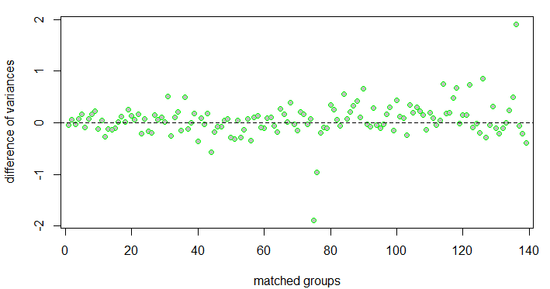
Exact Matching
Notes:
So, we managed to match 70% of our cases in 139 groups, and 57% of them showed a reduction in the variance of sentence length.
This is shown in this graph by the dots that are above the horizontal line at 0.
b) now, we can test whether each of these differences are statistically significant using an F-test for the ratio of variances, but how do we test whether the average group reduction in variability is significant?
c) The main problem is that we cannot just aggregate all the group variances before and after and compare them because their sample size varies, therefore some groups are much more representative of the population of offences of assault than others.

Slide 17
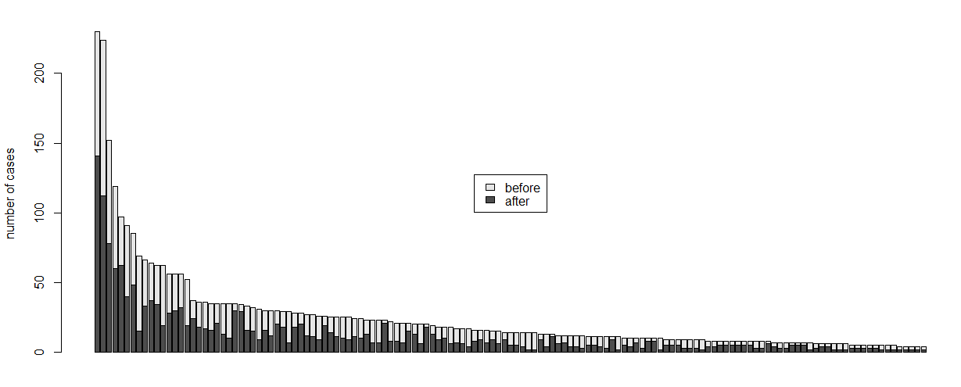
Exact Matching
Notes:
This graph illustrates very well the huge differences in sample size for the different groups used.
Sample sizes are represented by the vertical axis and the 139 matched groups are plotted on the horizontal axis, and we can see that while the top-ten groups have at least 30 cases both before and after, the last groups could have a sample as small as 2 cases before and after, less than that was excluded because basically a variance cannot be calculated.

Slide 18
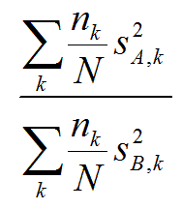
Exact Matching
In order to make exact matching represent the population of offences of assault we use weights,
The average sentence length variability within matched groups falls by 7.8%.
How do we test that this reduction is significant?
Notes:
K represents the matched group S2A and S2B the variances after and before and small n over capital N the sampling fraction of that matched group.
And like before the actual improvement might be higher than that since we saw that the variability of sentence length when we are not controlling for legal factors has gone up.
As I said before, we cannot just aggregate all the group variances before and after and run an F-test since each of them represent a different share of the population but also because they have been estimated with different levels of uncertainty.
Instead we use simulations. We estimate the sampling distribution of the null hypothesis indicating that the average weighted variance did not change. We generate 10,000 datasets that replicate our dataset of matched cases, we do so by taking random picks from normal distributions with variance the one of each before group and with a sample size the sample size of each group before and after. From each of these datasets we calculate and the test statistic and we plot them.

Slide 19
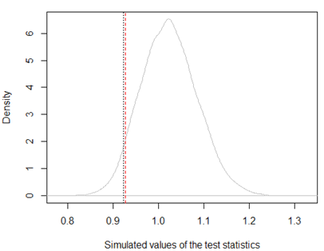
Exact Matching
Notes:
and we obtain this distribution,
This could be understood as the sampling distribution for our test statistic if the variances hadn’t changed, so the same variances are used for before and after, the reason why this distribution isn’t centered around 0 is because of the different sample sizes before and after, in particular the after scenario has systematically lower sample sizes.
now, the black vertical line indicates the value of the test statistic that we found in our data, .923,
we contrast that to the 5th percentile, which would be what we do using asymptotic theory in a one-tailed test,
the 5th percentile is the red vertical line, which is slightly to the right of the black one, in .926,
which determines that the reduction in the variance of matched groups is statistically significant for a 5% level of significance.

Slide 20
Conclusion
Measuring consistency precisely remains a tricky question, however, here we have shown that we can still look at major patterns of changes in consistency.
We have found an average statistically significant 7.8% reduction in sentence length variability within matched groups after the new guideline was implemented.
The improvement of consistency brought by the new guideline might be larger than that given the anticipatory effect observed in the before period and the increase in sentence length variability in the after period.
A majority of specific type of sentences have seen a reduction in sentence length variability, however we cannot confirm whether that change was significant. Future waves of data could help in that respect.
Notes:
So, in conclusion,
4) finally,

Slide 21

Questions?
Notes:
I do not know how much time I have left, but I will be happy to answer any questions that you might have.
Possible questions:
Response rates remain relatively constant across 2011 but we do not know whether the missing data mechanisms changed across that time, that is whether at the start of the year missing completely at random was more predominant than at the end.

